Slide 1



2024 Single Cell Workship Colombia: Introduction to Single-Cell RNA-Seq Experimental Methods
July 12-15, 2024
Bogota, Colombia

Slide 2
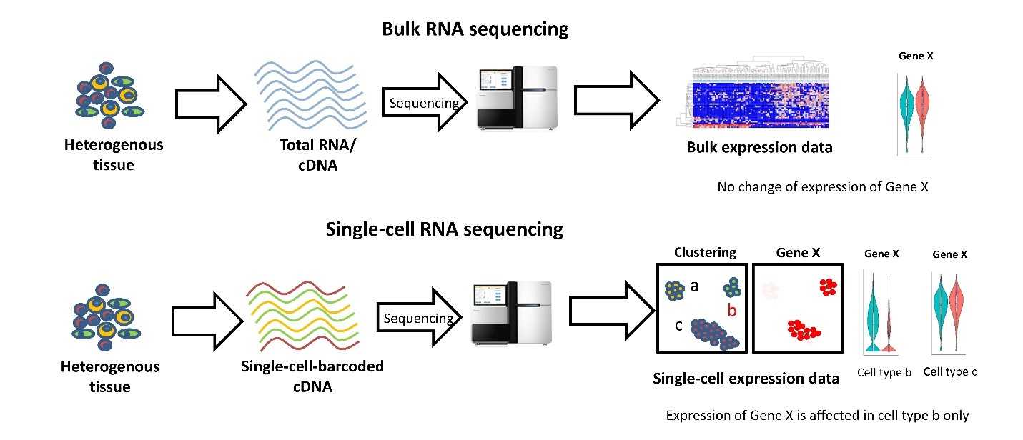
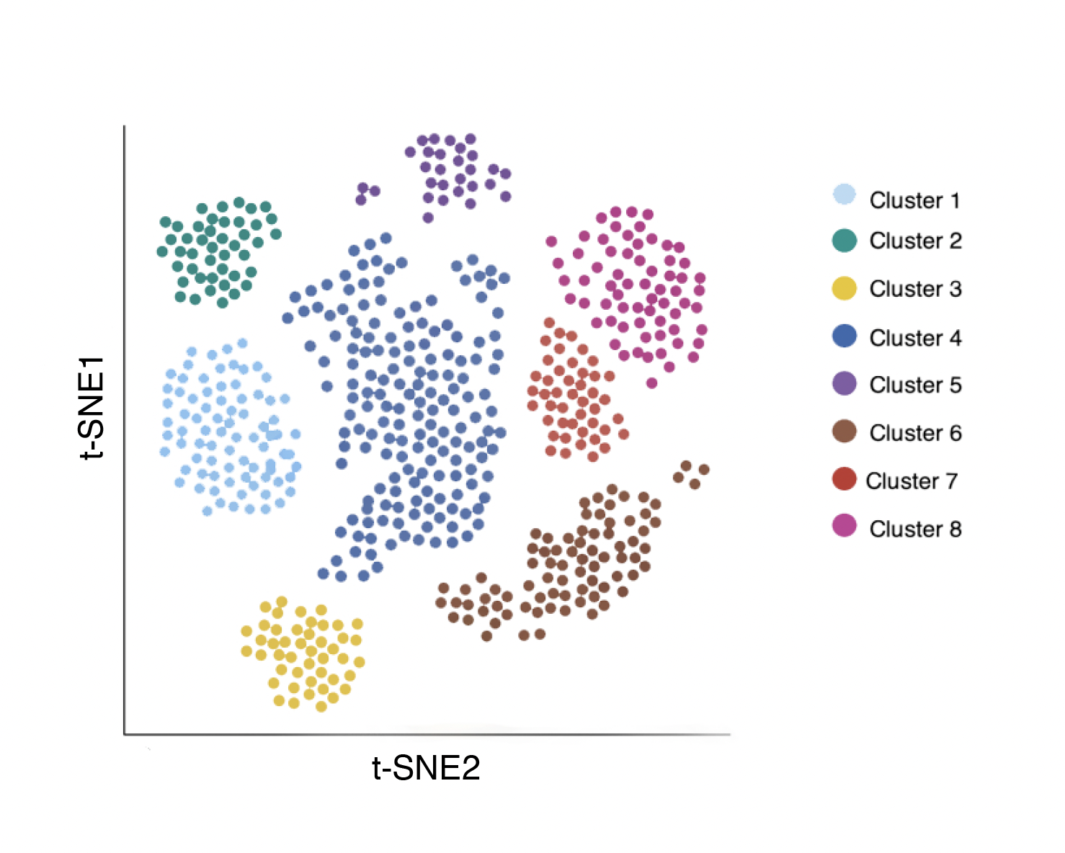
General overview of single-cell RNA workflows
Data Analysis
﻿”Bulk RNA sequencing vs Single-cell RNA sequencing”, Velmeshev (2019)
Notes:
This is the general process for many high-throughput single cell RNA sequencing workflows. Beginning with some heterogeneous sample, we remove DNA, protein, and cellular debris in order to isolate mRNA. The mRNA is reverse transcribed and barcoded resulting in a cDNA library. The prepared library is sequenced, yielding millions of reads(or genes) which need to be mapped to a reference genome. The final result is an expression matrix of cells and genes that can be further analyzed. The main point of difference for many of the high-throughput methods is how the barcoded library is generated.
_______________
Before the emergence of scRNA-seq technology, RNA was profiled using Bulk RNA sequencing, which provides an average expression profile of all the cells in the sample. However, single-cell RNA sequencing can break down the spectrum by enabling the dissection of gene expression at the single cell level.The cDNA product is subsequently amplified by PCR. The amplified whole transcriptome product is barcoded and tagmented to prepare a library for sequencing.

Slide 3
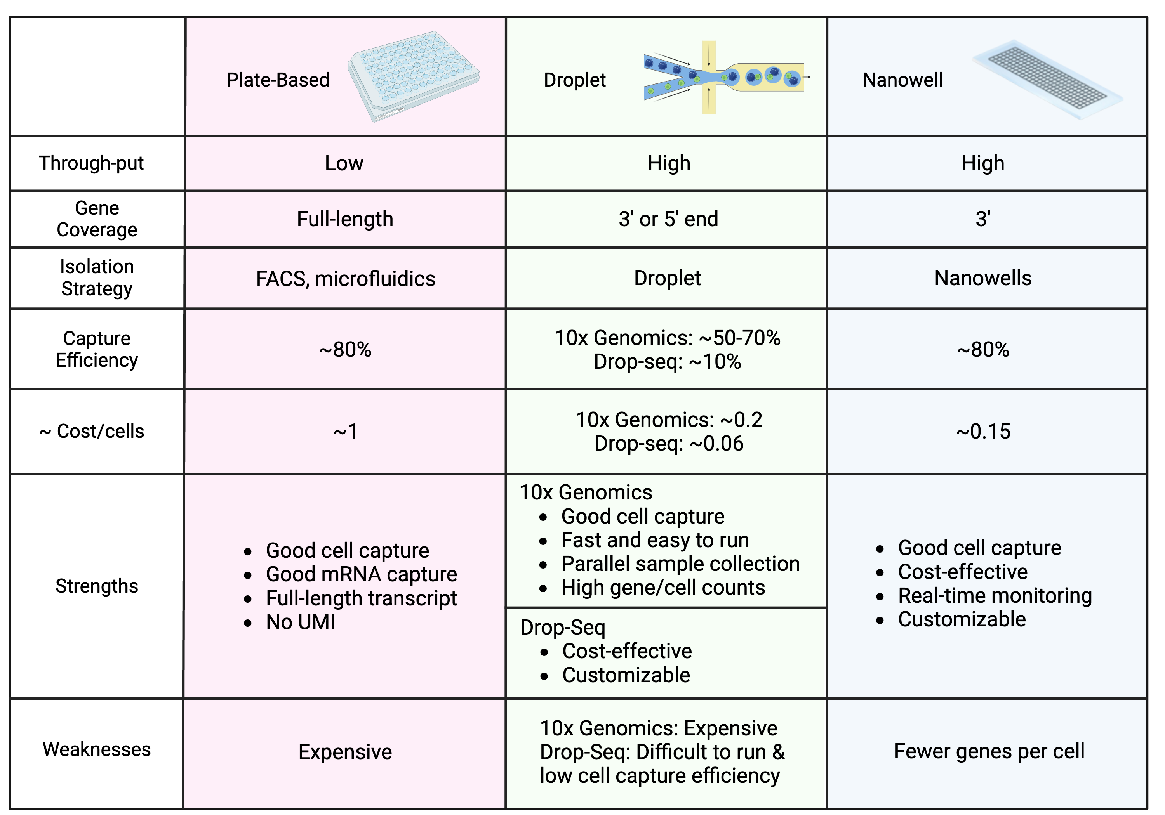
There are many single-cell RNA sequencing methods

Slide 4
Considerations For Single-Cell RNA-Seq
Choose protocol based on:
• Throughput (# of cells / reaction )
• Sample of origin
• Cost / Labor / Time limitations
• Gene body coverage - 5’, 3’ biased, or full-length?
• UMI vs no-UMI
• Sequencing depth / cell
For example:
• To classify all cell types in a diverse tissue (e.g., brain), I need high throughput
• To re-annotate the transcriptome or find new isoforms, I need full-length coverage
• I only have archival human samples so I need to use a method that permits fixed cells (or nuclei)

Slide 5
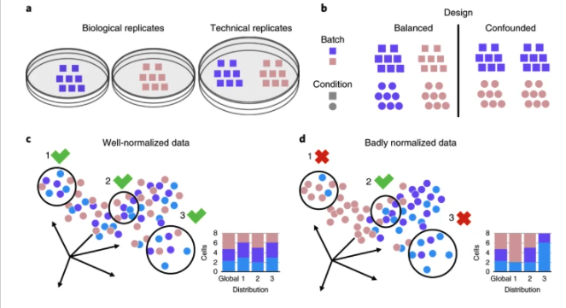
What is batch correction?
Batch effect correction is the procedure of removing variability from your data that is not due to your variable of interest
Batch effects are due to technical differences
Who collected samples
Who processed samples
When were they processed
Büttner et al. (2018) Nature Methods

Slide 6
Some major sources of batch effects:
General
Groups of samples collected together
Groups of samples that are processed together
WHO performs library preparation
Technology Specific
10X Genomics: Different 10X chips
Seq-Well/Honeycomb: Arrays processed at once
SMART-Seq: Each plate

Slide 7
How can we minimize batch effects?
Try your best!
Consider all of your metadata variables – what groups of samples do you have?
Which are the most important to your scientific question?
Include 1 sample of each major variable as possible

Slide 8
Optimizing tissue dissociation for high quality single cell suspensions
Choosing the appropriate dissociation method
Timing of the dissociation
Temperature and incubation time
Enzyme concentration
Gentle handling
Notes:
Overall, optimizing tissue dissociation for single cell RNA sequencing requires careful consideration of these factors to ensure that high quality, single cell suspensions are obtained.

Slide 9
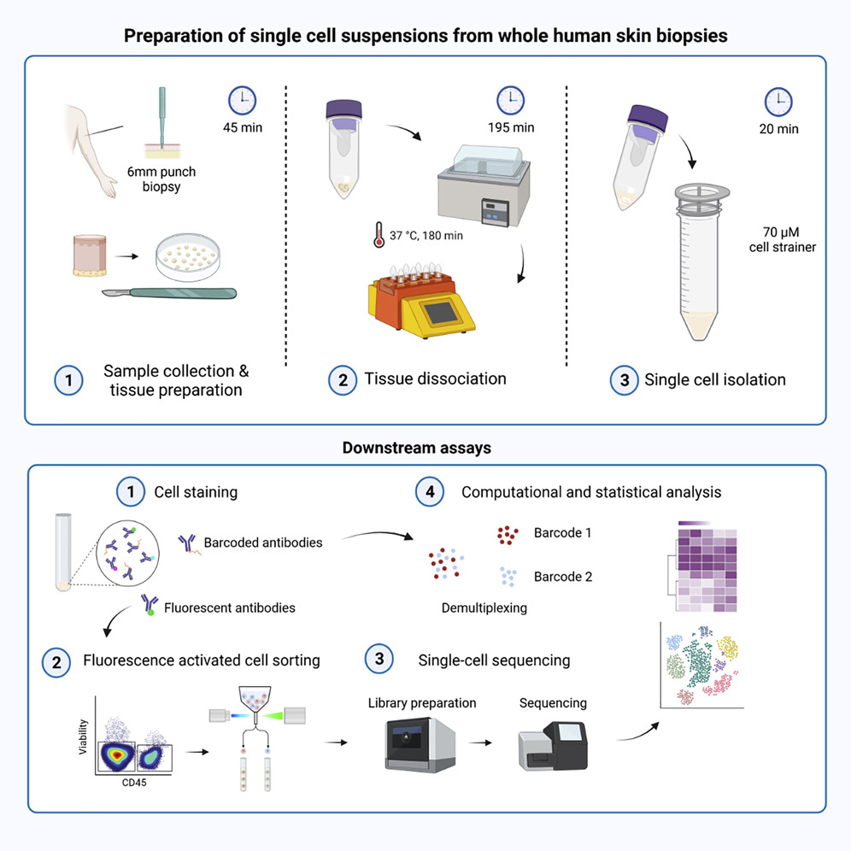
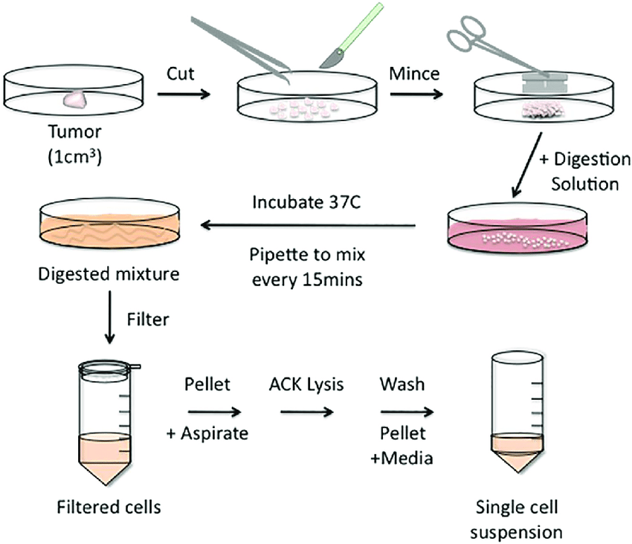
Unique tissues require unique methods for dissociation
Cytometry Pt A, Volume: 95, Issue: 2, Pages: 219-226, First published: 06 December 2018, DOI: (10.1002/cyto.a.23690)
Notes:
https://www.sciencedirect.com/science/article/pii/S2666166720300113?via%3Dihub
Cytometry Pt A, Volume: 95, Issue: 2, Pages: 219-226, First published: 06 December 2018, DOI: (10.1002/cyto.a.23690)

Slide 10



Working with Fresh Cells/Nuclei Can Have Some Challenges
Cells or tissues may suffer the loss of viability from sample transportation
Cryopreservation may not be accessible for long travel
Not all cells survive cryopreservation
Proper sample storage and preparation are essential
Acquiring precious samples can happen at unpredictable times of day or night
Core lab facilities may not have flexible hours
Sample preservation and stability is top priority to acquire great data quality
Notes:
Advantages of sample fixation:
1.) For projects including long-distance transportation of samples, cells or tissues may suffer the loss of viability from physical impact during transport or improper storage conditions.
2.) Sample preservation methods can allow more flexible experimental designs; specifically, it can help to store samples collected from different experimental conditions or time points and enable them to be consolidated.
3.) Acquiring fresh samples especially from clinical collaborators may be very unpredictable (early mornings or very late nights).
4.) Aside from just logistics, some samples may contain infectious agents or pathogens, which can make it inconvenient to perform all the in a BSL-3 lab. By fixing your samples, you can neutralize infectious agents and continue to work in lower-risk BSL spaces.

Slide 11
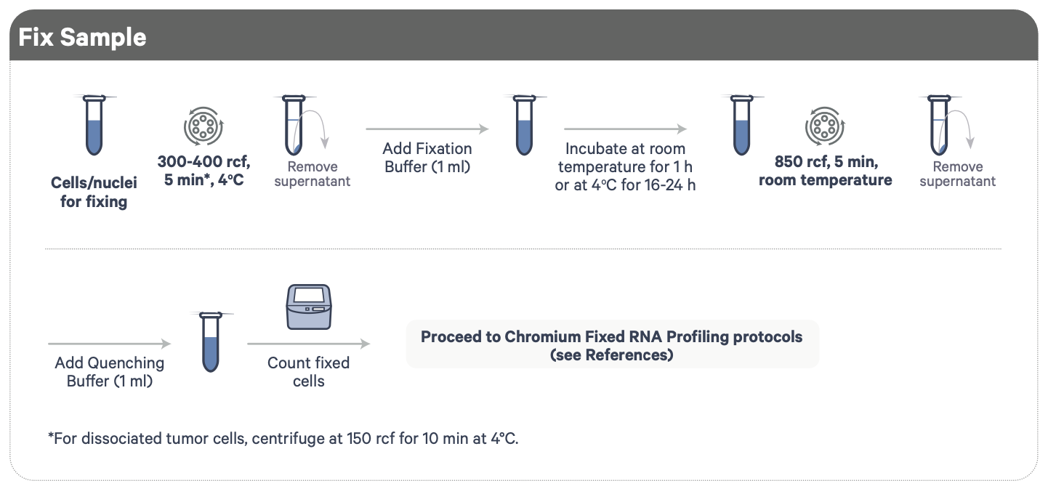
Fixing Isolated Nuclei and Cell Suspensions
Contains formaldehyde!
Demonstrated Protocol | Fixation of Cells & Nuclei for Chromium Fixed RNA Profiling
Notes:
We’ll be taking advantage of a fixation protocol for processing our cells and nuclei. We spin down our cells/nuclei and treat them with a fixation buffer, which contains a mild detergent to help permeabilize the sample as well as formaldehyde which involves in cross-linking of proteins to preserve the biological state of our samples and prevent degradation.
IMPORTANT: Formaldehyde must be used under a fume hood with proper ventilation!
After fixation, we spin down again and replace with quenching buffer to inactivate the fixation as prolong fixation can very much affect sample quality.

Slide 12
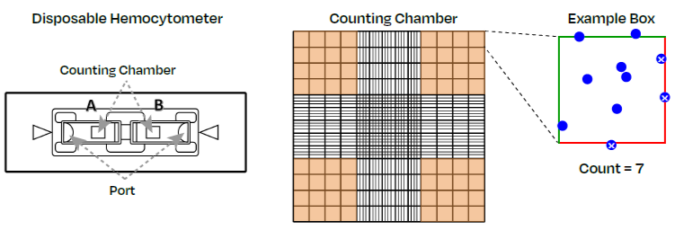
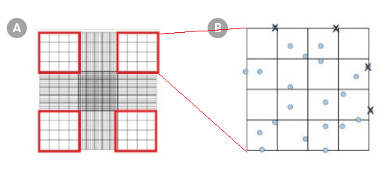
Cell Counting using a Hemocytometer

Slide 13
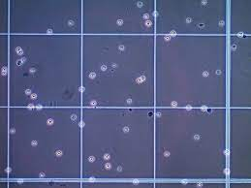
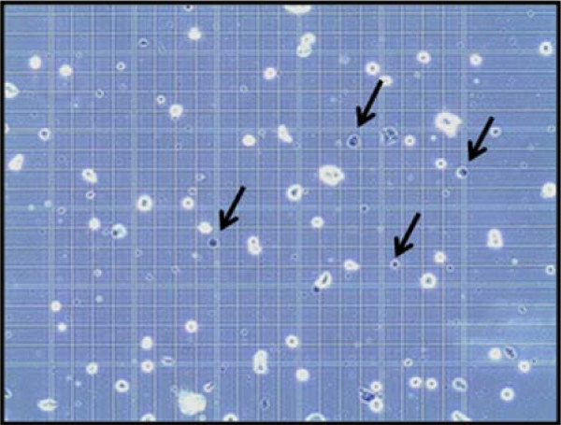
Live vs dead cells on the hemocytometer

Slide 14
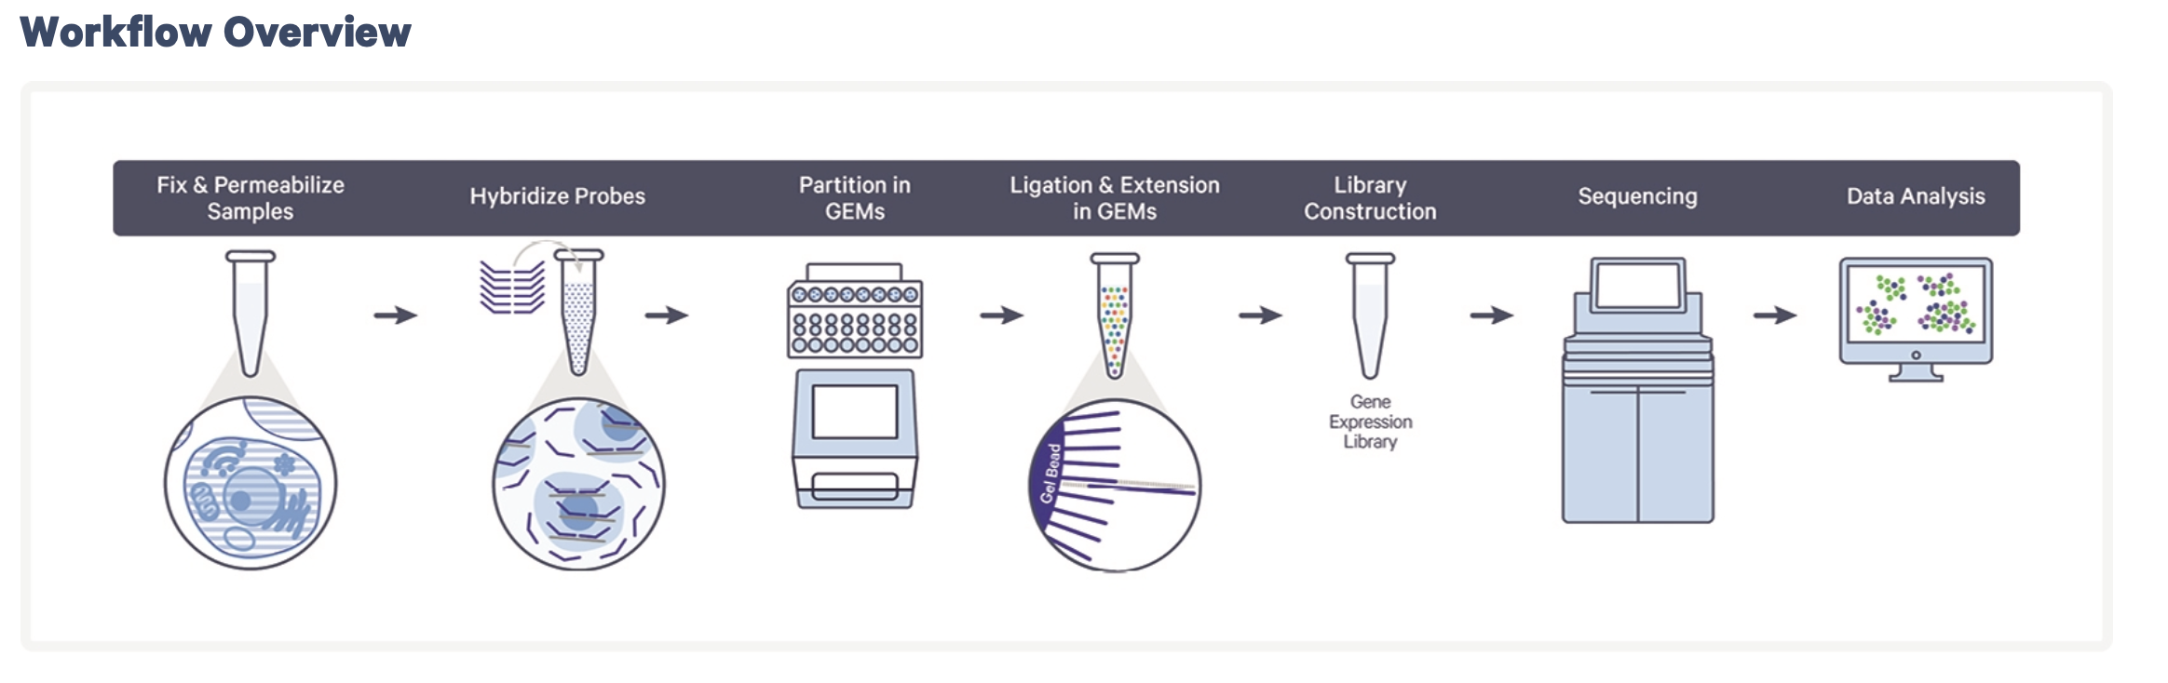
Chromium Fixed RNA Profiling –Overview
Notes:
For this workflow, fixed samples are first hybridized with Probe Barcodes. Then using a microfluidic chip, the hybridized samples are then partitioned into nanoliter-scale Gel Beads-in-emulsion (GEMs). A pool of ~737,000 10x GEM Barcodes (also referred to as 10x Barcodes) is sampled separately to index the
contents of each partition.
Inside the GEMs, probes are ligated and the 10x GEM Barcode is added, and all ligated probes within a GEM share a common 10x GEM Barcode. Barcoded and ligated probes are then pre-amplified in bulk, after which gene expression libraries are generated and sequenced.
Let’s go into a bit more detail as to what is happening in each step, starting with the hybridized probes.

Slide 15
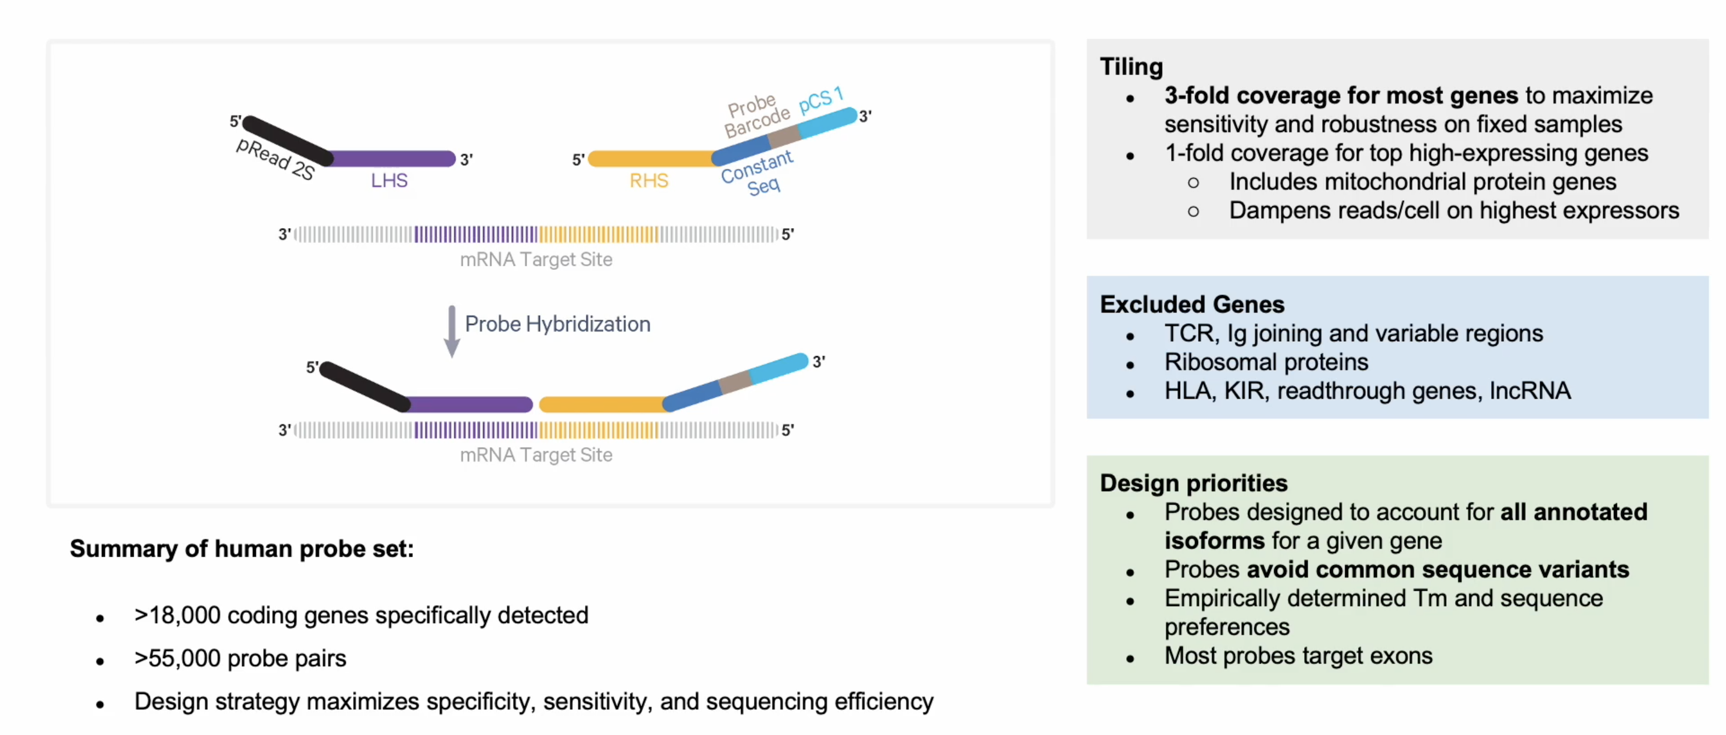
Chromium Fixed RNA Profiling–Probe Hybridization
10X Genomics Fixed RNA Assay
Notes:
In traditional 10X assays, transcripts are captured either at the 3’ end (via polyA capture), or the 5’ end. But because fixation can lead to sample RNA degradation, we want to only capture RNA molecules of interest, so the probes are specifically designed to bind to complementary RNA of target sites from both the 3’ and 5’ region.
The probes bind to adjacent sites on their target transcripts, are then ligated together, and then become the substate for library construction further down the line.
The 10X probes are highly sensitive and allow for 3-fold coverage of most genes, however, one drawback is that these probes are very specific, so several genes include those for TCR, or lncRNA might be excluded, therefore a specific probe set for looking at such genes will need to be designed (costly) .

Slide 16
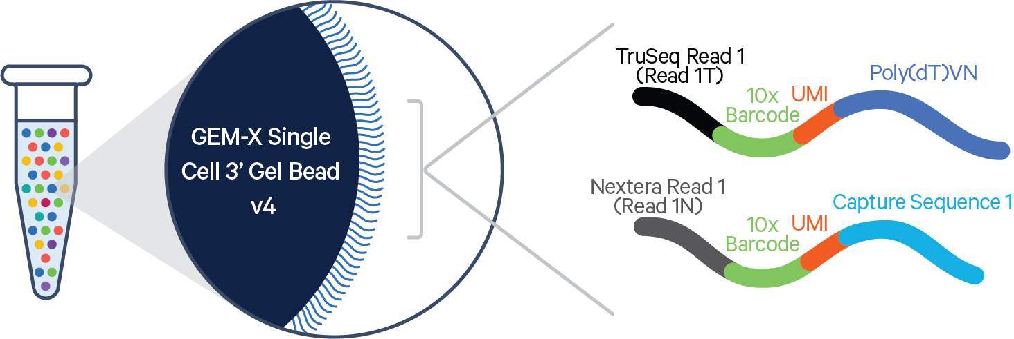
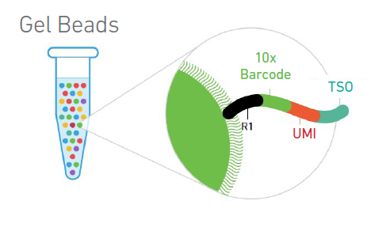
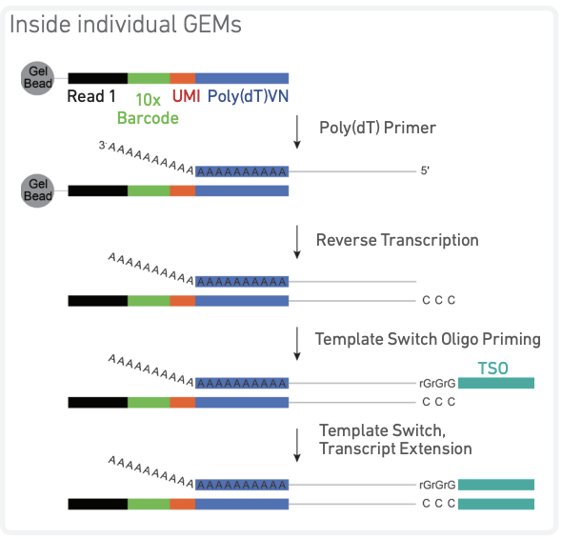
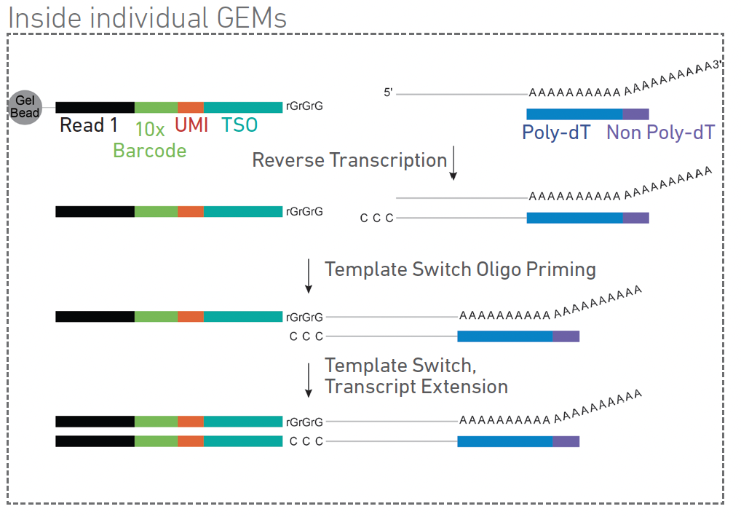
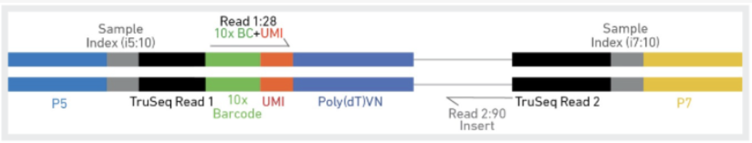
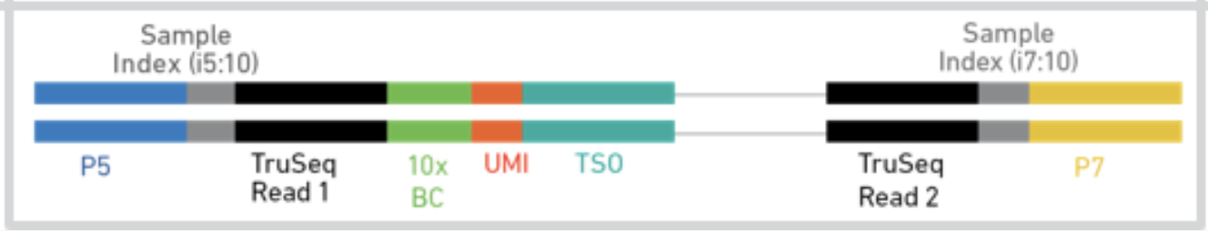
Chromium Fixed RNA Profiling Chemistry
Notes:
Barcode Placement: The 3' assay captures the 3' end of the transcript, while the 5' assay captures the 5' end. This difference influences the types of sequences detected—3' assay is better for transcript quantification, while the 5' assay provides more information about transcription start sites and exonic regions.
Gene Coverage: The 5' assay captures more exonic molecules and fewer intronic ones compared to the 3' assay. This can lead to longer average read lengths and more complete transcript coverage in the 5' assay.
Cell-Type Identification: Both assays yield highly correlated cell-type-specific isoform profiles, although there are slight differences in the detection of certain genes and transcripts based on the assay used.
Application Suitability: The choice between 3' and 5' assays depends on the specific research question. For example, the 3' assay is preferred for general gene expression profiling, while the 5' assay is advantageous for studying transcription start sites and splice variants.
Main advantages / disadvantages
• + Paired information from a single cell + pair with whole transcriptome or other methods (i.e. cell surface protein expression)
• + 1 UMI per transcript
• - We don’t sequence the full transcript
• - Requires specific equipment (expensive) Biases:
• Enriches for 5’end (less validated)
• Depends on polyA capture efficiency
• Size of VDJ varies between cells
• For full transcriptome you are more likely to capture the most abundant transcripts
• Very short and very long transcripts will be less likely to be captured • GC content is always an issue

Slide 17
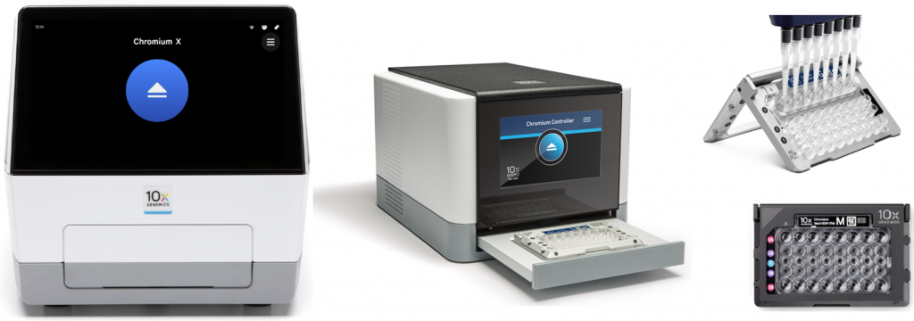
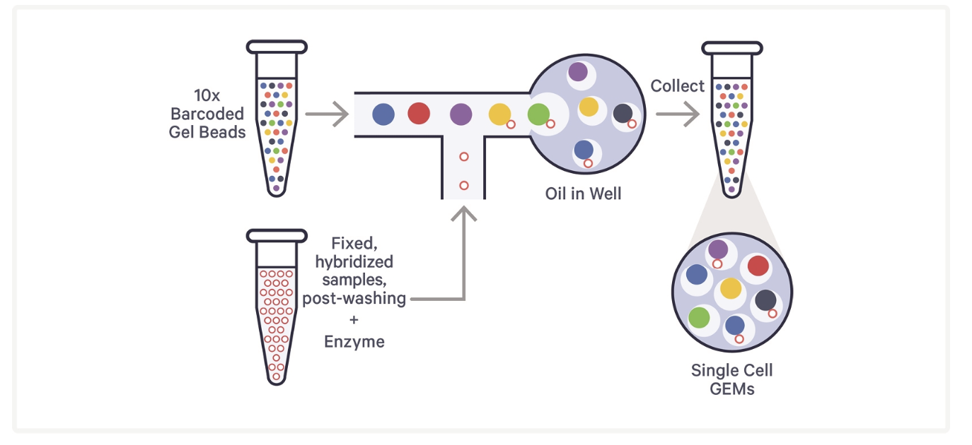
Chromium Fixed RNA Profiling–Cell Loading
Notes:
GEMs (Gel Bead-in-Emulsion): Released in solution Cell Preparation: Fixed cells with hybridized probes are prepared in a suspension with a high viability percentage (>80%) to ensure accurate capture. The cells must be well-dissociated to avoid clumping, as single-cell isolation is crucial for the process.
Microfluidic Partitioning: The cell suspension is loaded onto a microfluidic chip, which is part of the 10x Chromium Controller. The controller uses microfluidics to partition individual cells into oil droplets.
Gel Bead-in-Emulsion (GEM) Formation: Each oil droplet contains a single cell along with a barcoded gel bead. These gel beads are preloaded with oligonucleotides that include a unique barcode sequence, a poly-dT sequence for mRNA capture, and a template switching oligo (TSO).
Cell Lysis and mRNA Capture: Once the cells are partitioned into droplets, cell lysis occurs within each droplet, releasing the mRNA. The poly-dT sequence on the gel bead oligonucleotide captures the polyadenylated mRNA molecules.
Reverse Transcription and Barcoding: The TSO helps initiate reverse transcription, converting mRNA into cDNA while incorporating the unique barcode. This barcode tags all cDNA from the same cell, allowing for the identification of the cell of origin during sequencing.
Library Construction: The barcoded cDNA is then amplified, fragmented, and prepared for sequencing. Sequencing: The prepared libraries are then sequenced using high-throughput sequencing platforms, typically from Illumina. The resulting data includes reads that can be traced back to individual cells thanks to the unique barcodes.
Data Analysis: Bioinformatics tools, such as the Cell Ranger pipeline provided by 10x Genomics, are used to process the sequencing data. These tools demultiplex the reads, align them to a reference genome, and quantify gene expression and V(D)J sequences.

Slide 18
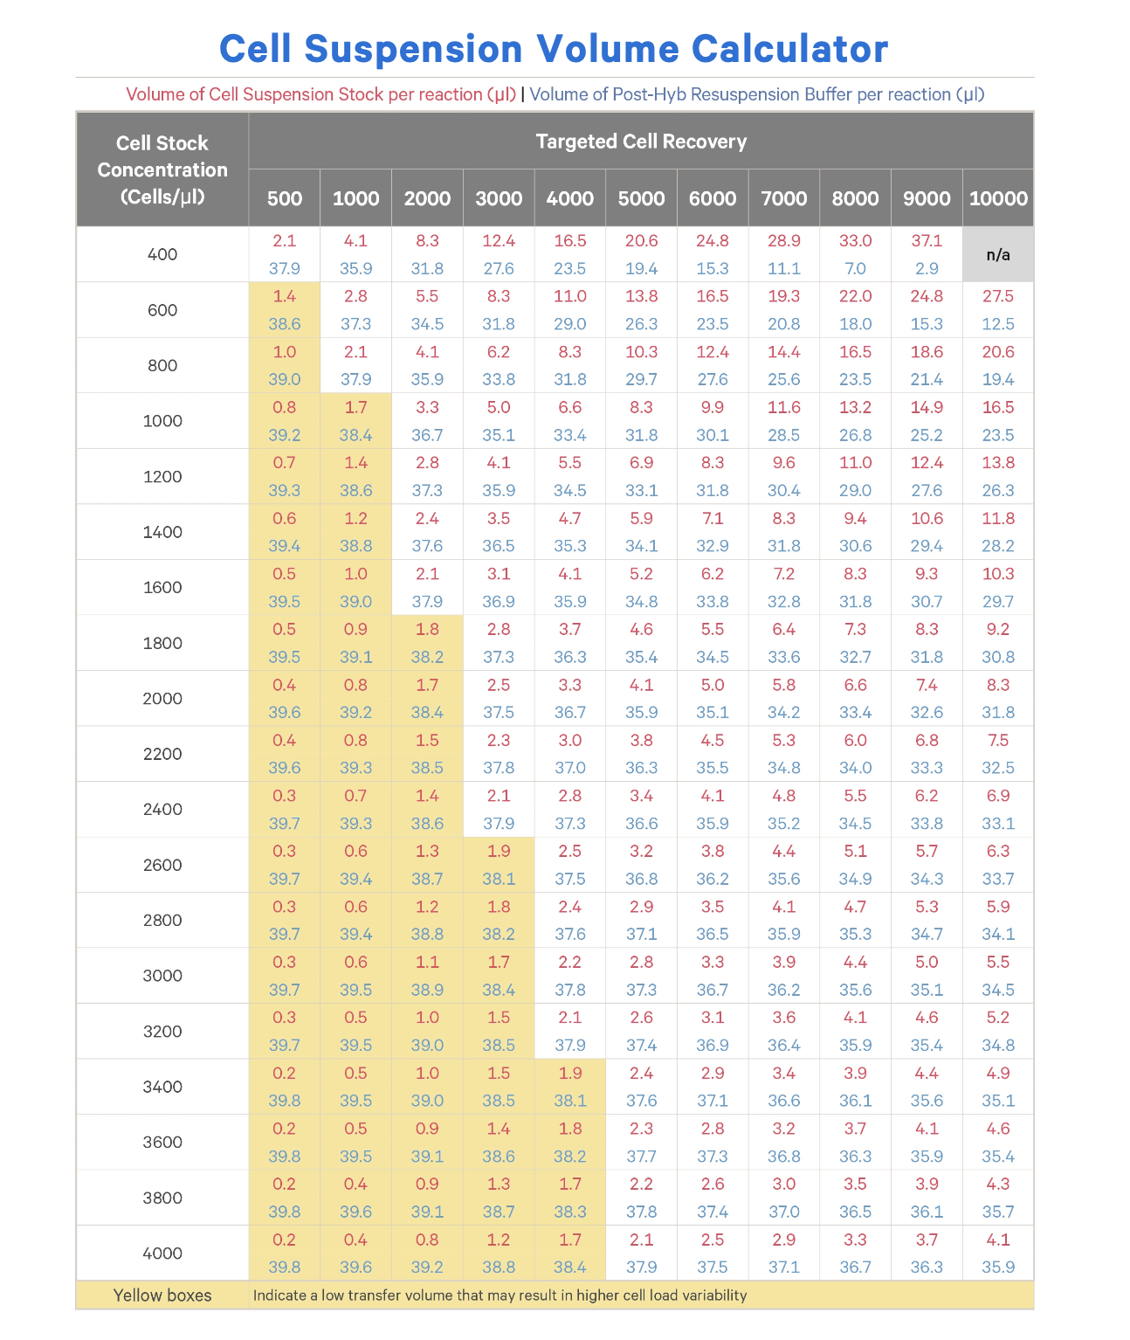
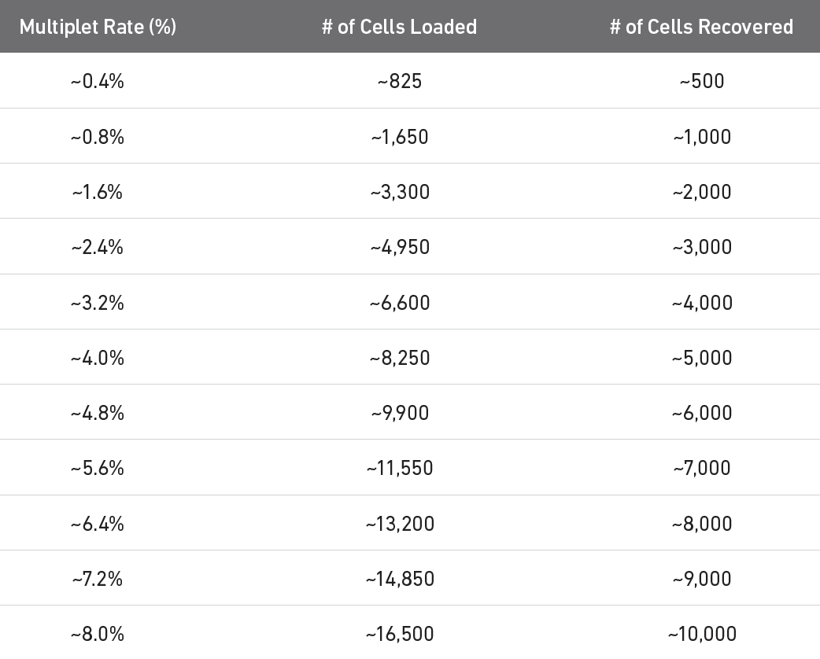
Determine the number of cells we want to load

Slide 19
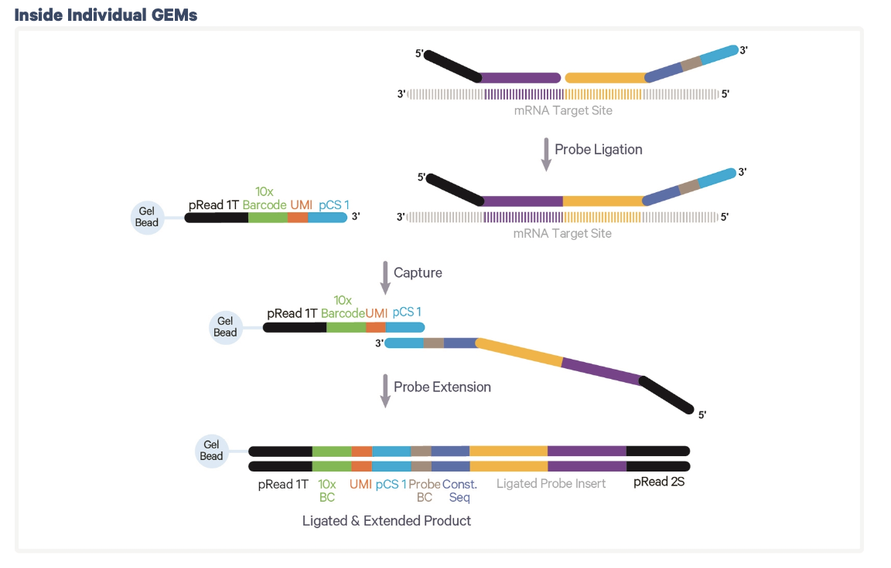
Post-GEM formation
What we have now:
Read 1 sequencing primer
Barcode
UMI
poly(dT) sequence
Notes:
an Illumina TruSeq Read 1 (read 1 sequencing primer)
16 nt 10x Barcode
12 nt unique molecular identifier (UMI)
30 nt poly(dT) sequence

Slide 20
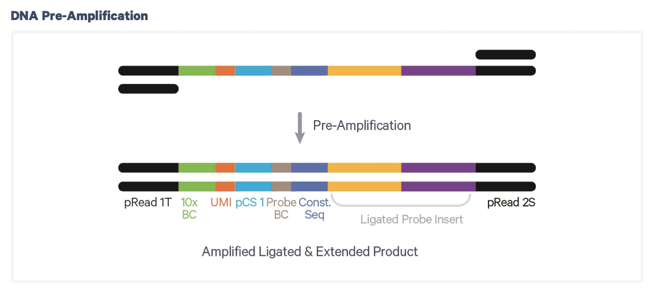
Post-Reverse Transcription
What we have:
Barcoded, full-length cDNA
Notes:
an Illumina TruSeq Read 1 (read 1 sequencing primer)
16 nt 10x Barcode
12 nt unique molecular identifier (UMI)
30 nt poly(dT) sequence

Slide 21
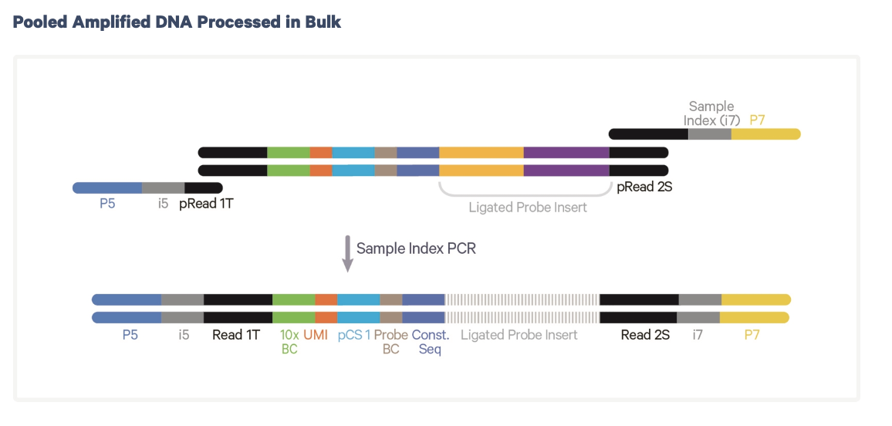
Gene Expression Library Construction
What we have:
Barcoded, full-length cDNA
Notes:
an Illumina TruSeq Read 1 (read 1 sequencing primer)
16 nt 10x Barcode
12 nt unique molecular identifier (UMI)
30 nt poly(dT) sequence

Slide 22
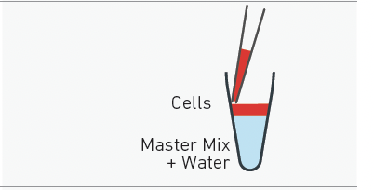
Add 36.6 µL of master mix + water before adding cells
Notes:
36.3 µL MM and

Slide 23
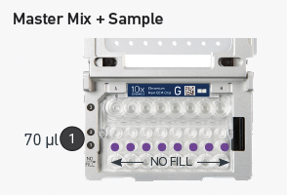
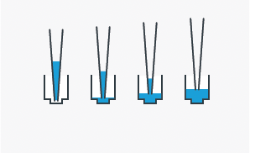
Add 70 µL of sample to chip

Slide 24
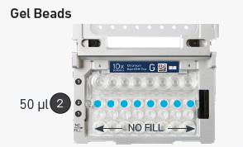
Add 50 µL of gel beads to the chip

Slide 25
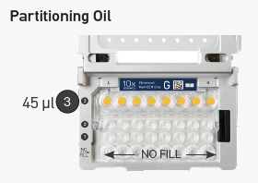
Add 45 µL of partitioning oil to the chip

Slide 26
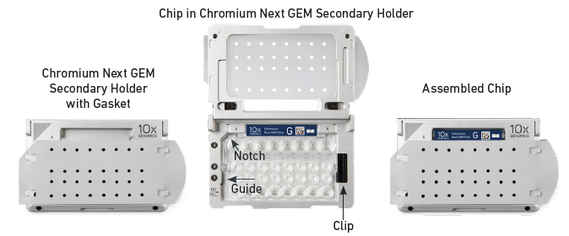
Cell Loading – 10x

Slide 27
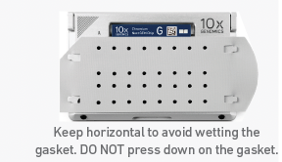
CAREFULLY add the gasket cover

Slide 28
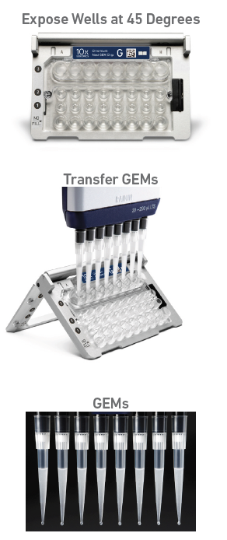
Remove the GEMs from the chip

Slide 29
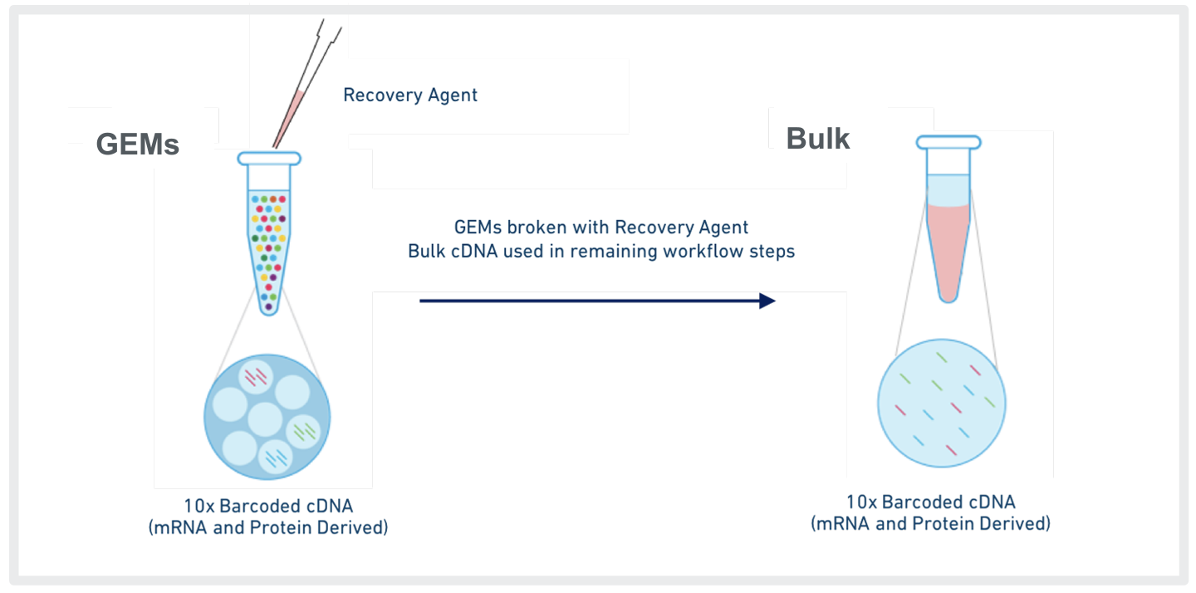
Breaking the GEMs

Slide 30
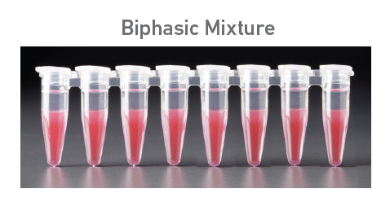
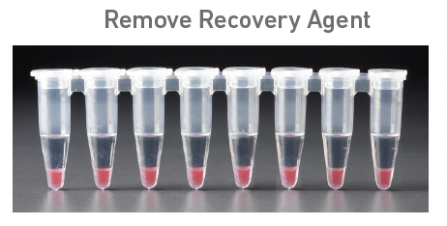

Slide 31
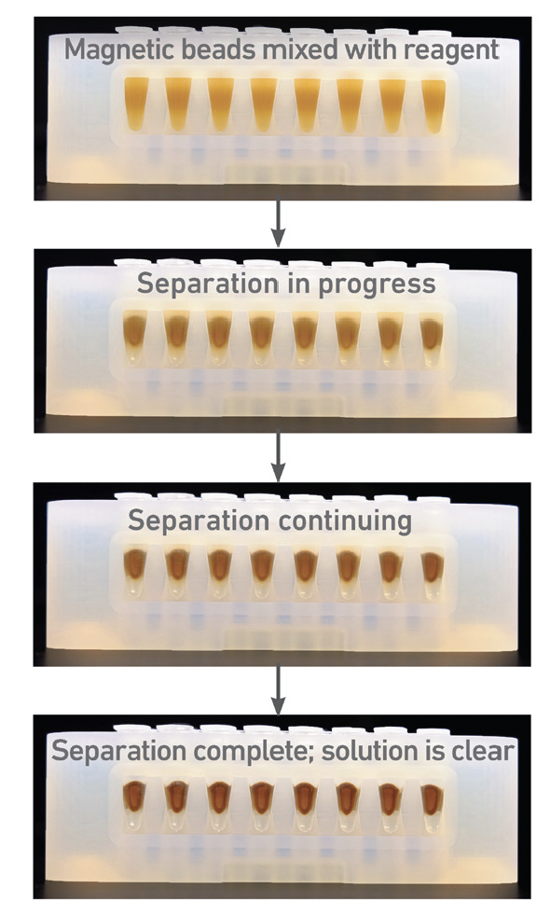
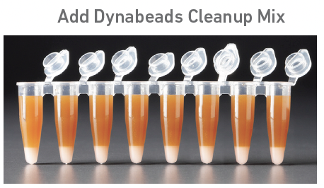

Remove the GEMs from the chip

Slide 32
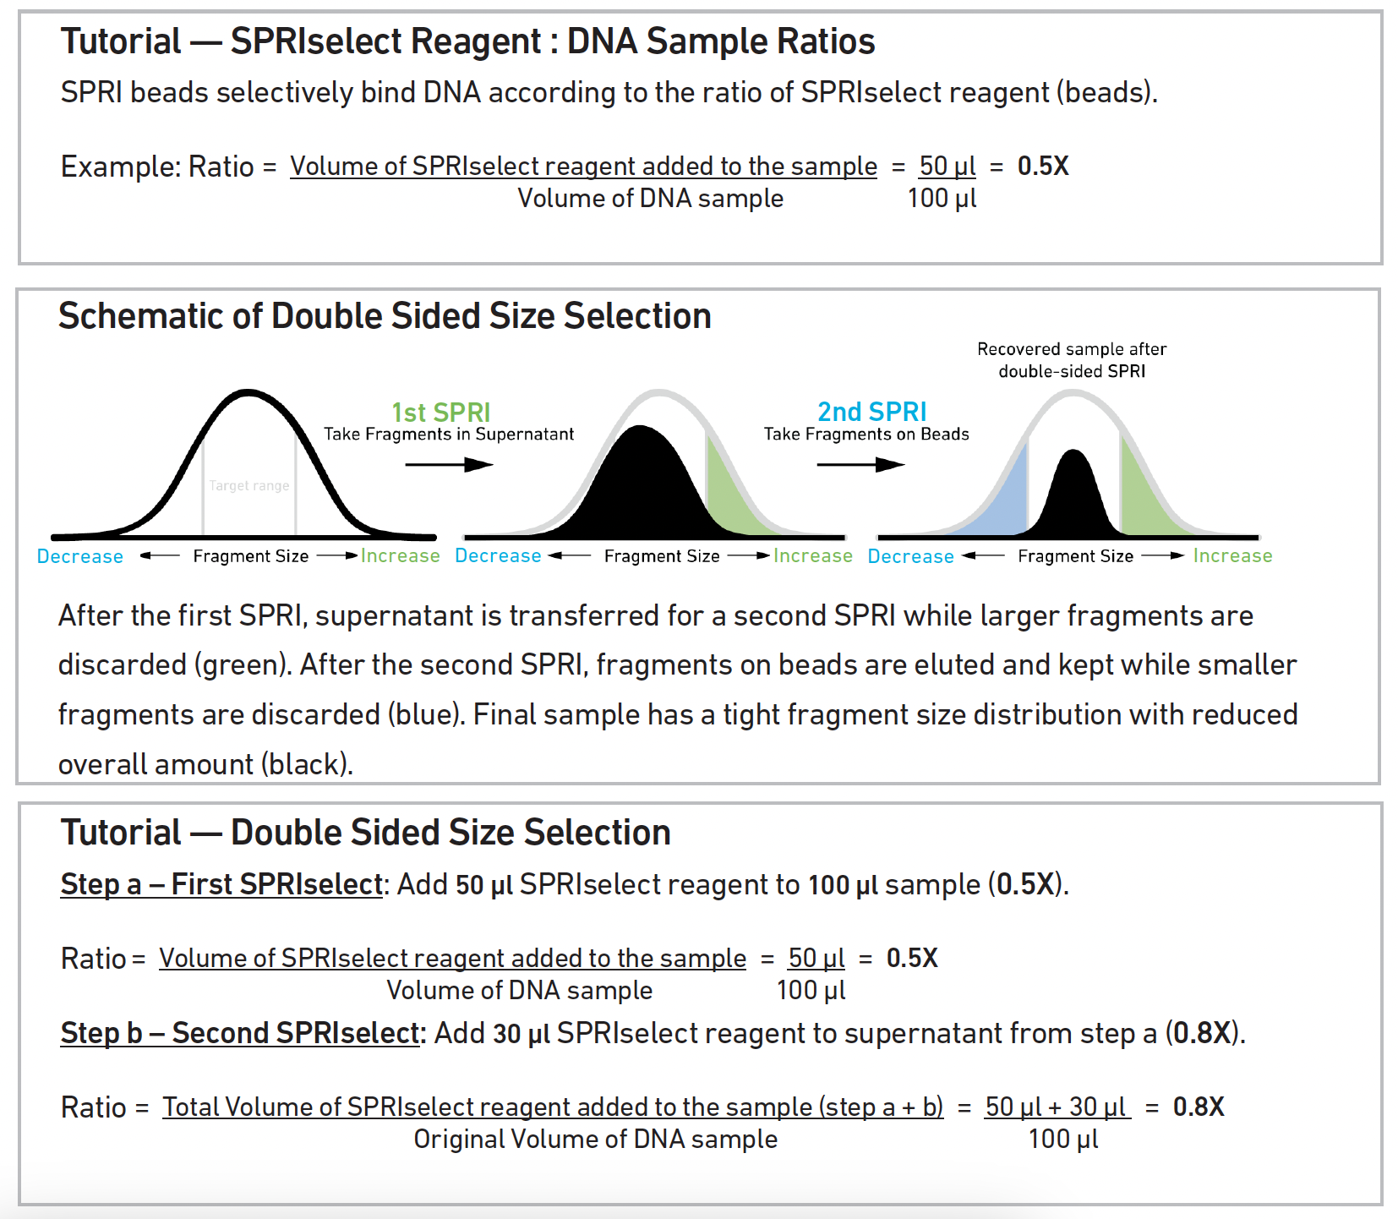

Slide 33
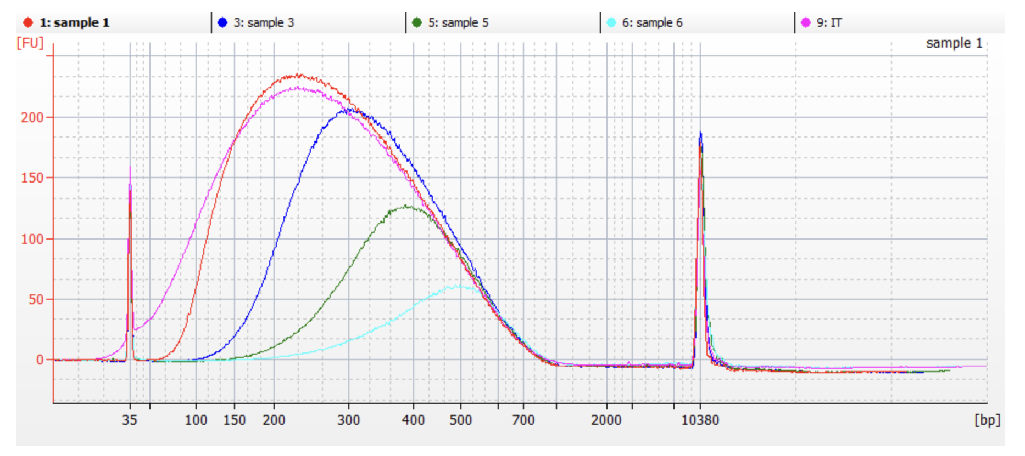
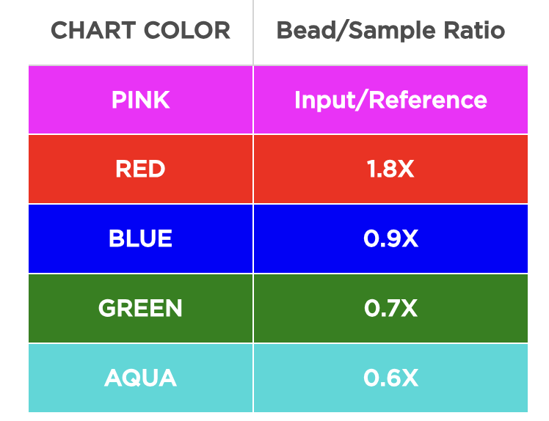
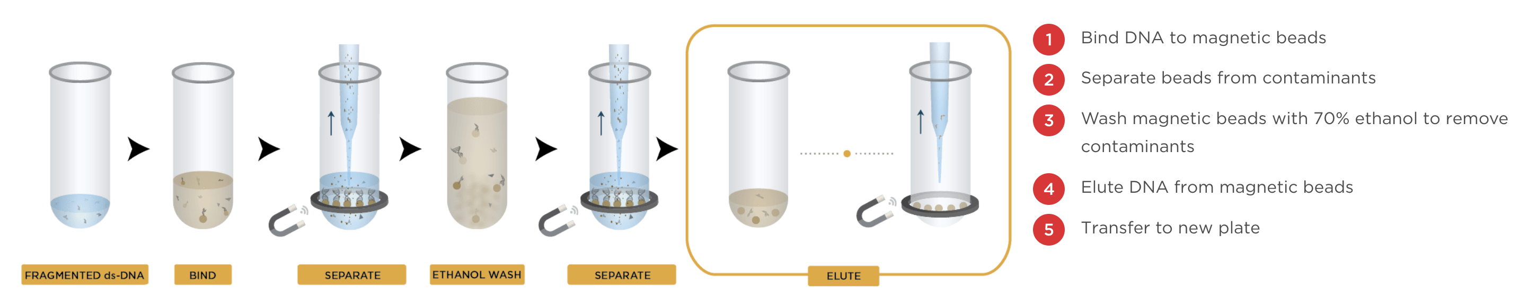
DNA Cleanup

Slide 34
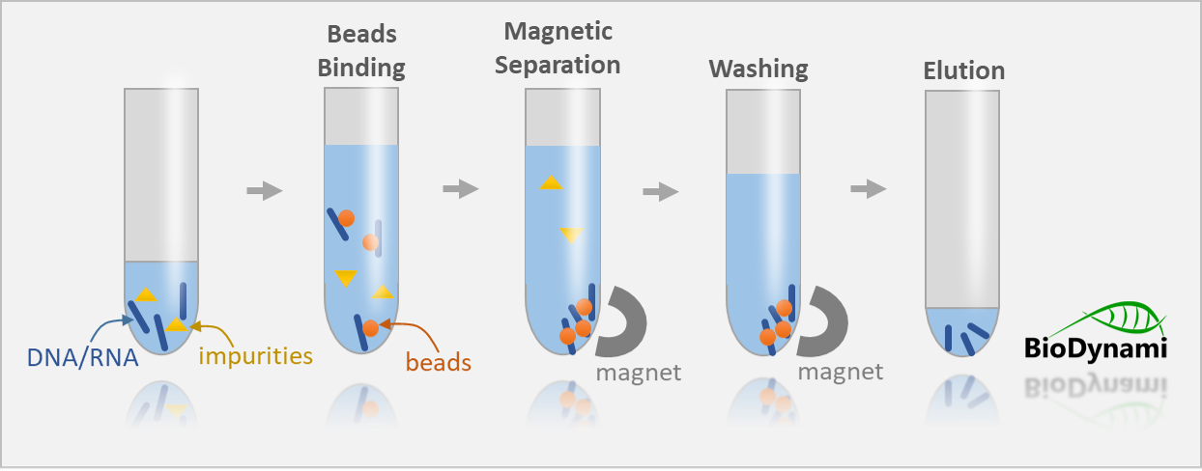
Double sided SPRI

Slide 35
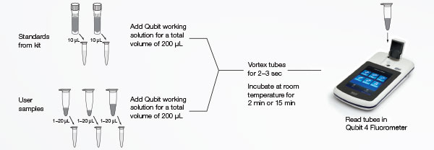
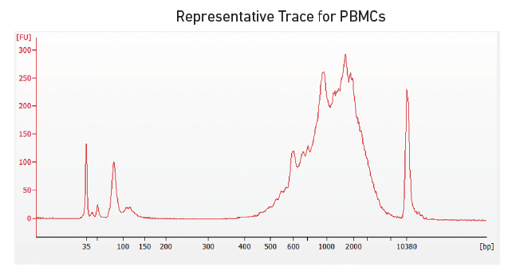
Quality Control
Notes:
P5, P7, i7 and i5 sample indexes, and TruSeq Read 2 (read 2 primer sequence) are added via End Repair, A-tailing, Adaptor Ligation, and PCR

Slide 36
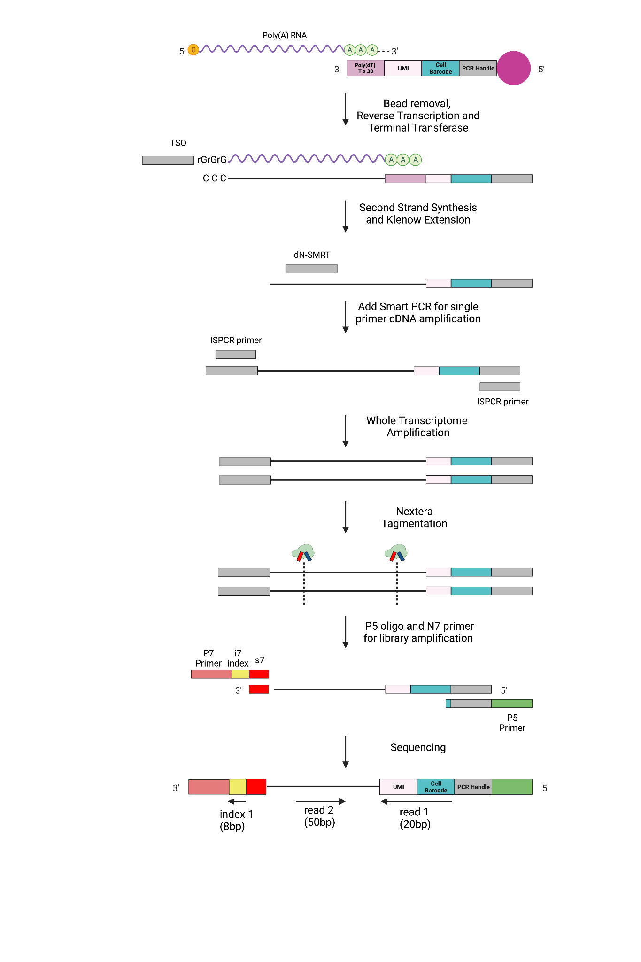


Downstream Steps
Reverse Transcription
Second Strand Synthesis
WTA (PCR)
Library Prep
NGS and Analysis
Notes:
Once the beads with the hybridized mRNA have been isolated in eppendorf tubes, we perform the standard reverse transcription to generate the full length of cDNA. This is done by incubating the reverse transcription mixture which includes a template switching oligo (TSO) used as a universal priming site for PCR amplification at the 3’ end. Thus, this will hybridize to the 5’-untemplated C-bases (added by terminal transferase) for full-length cDNA synthesis and amplification.
Sarah

Slide 37
Downstream Steps
RT and Exo digestion
Second Strand Synthesis
WTA (PCR)
Library Prep
NGS and Analysis
cDNA
Notes:
During RT, sometimes we don’t get this template switching which is essential for the amplification of cDNA. In these cases, the absence of the trailing C’s prevents TSO from binding to the cDNA and consequently, the PCR primer does not reverse transcribe onto the cDNA necessary from PCR amplification and you lose a lot of transcripts.
Thus to improve transcript recovery, seq-well adds an additional step called second strand synthesis which incorporates a randomer primer, dN-SMRT, which will bind to parts of the cDNA to recover transcripts lost during inefficient template switching, as shown in the figure in the right.
To do that, we basically perform denaturation by washing the barcoded mRNA beads with 0.1M NaOH which will remove the attached RNA template. Then with the help of the klenow enzyme labeled with SMART sequence, there will be primers that will let us make this first length cDNA but will also come down and bind to its reverse complement to make sure that things that are double stranded are going to be amplified. only one strand is shown here

Slide 38
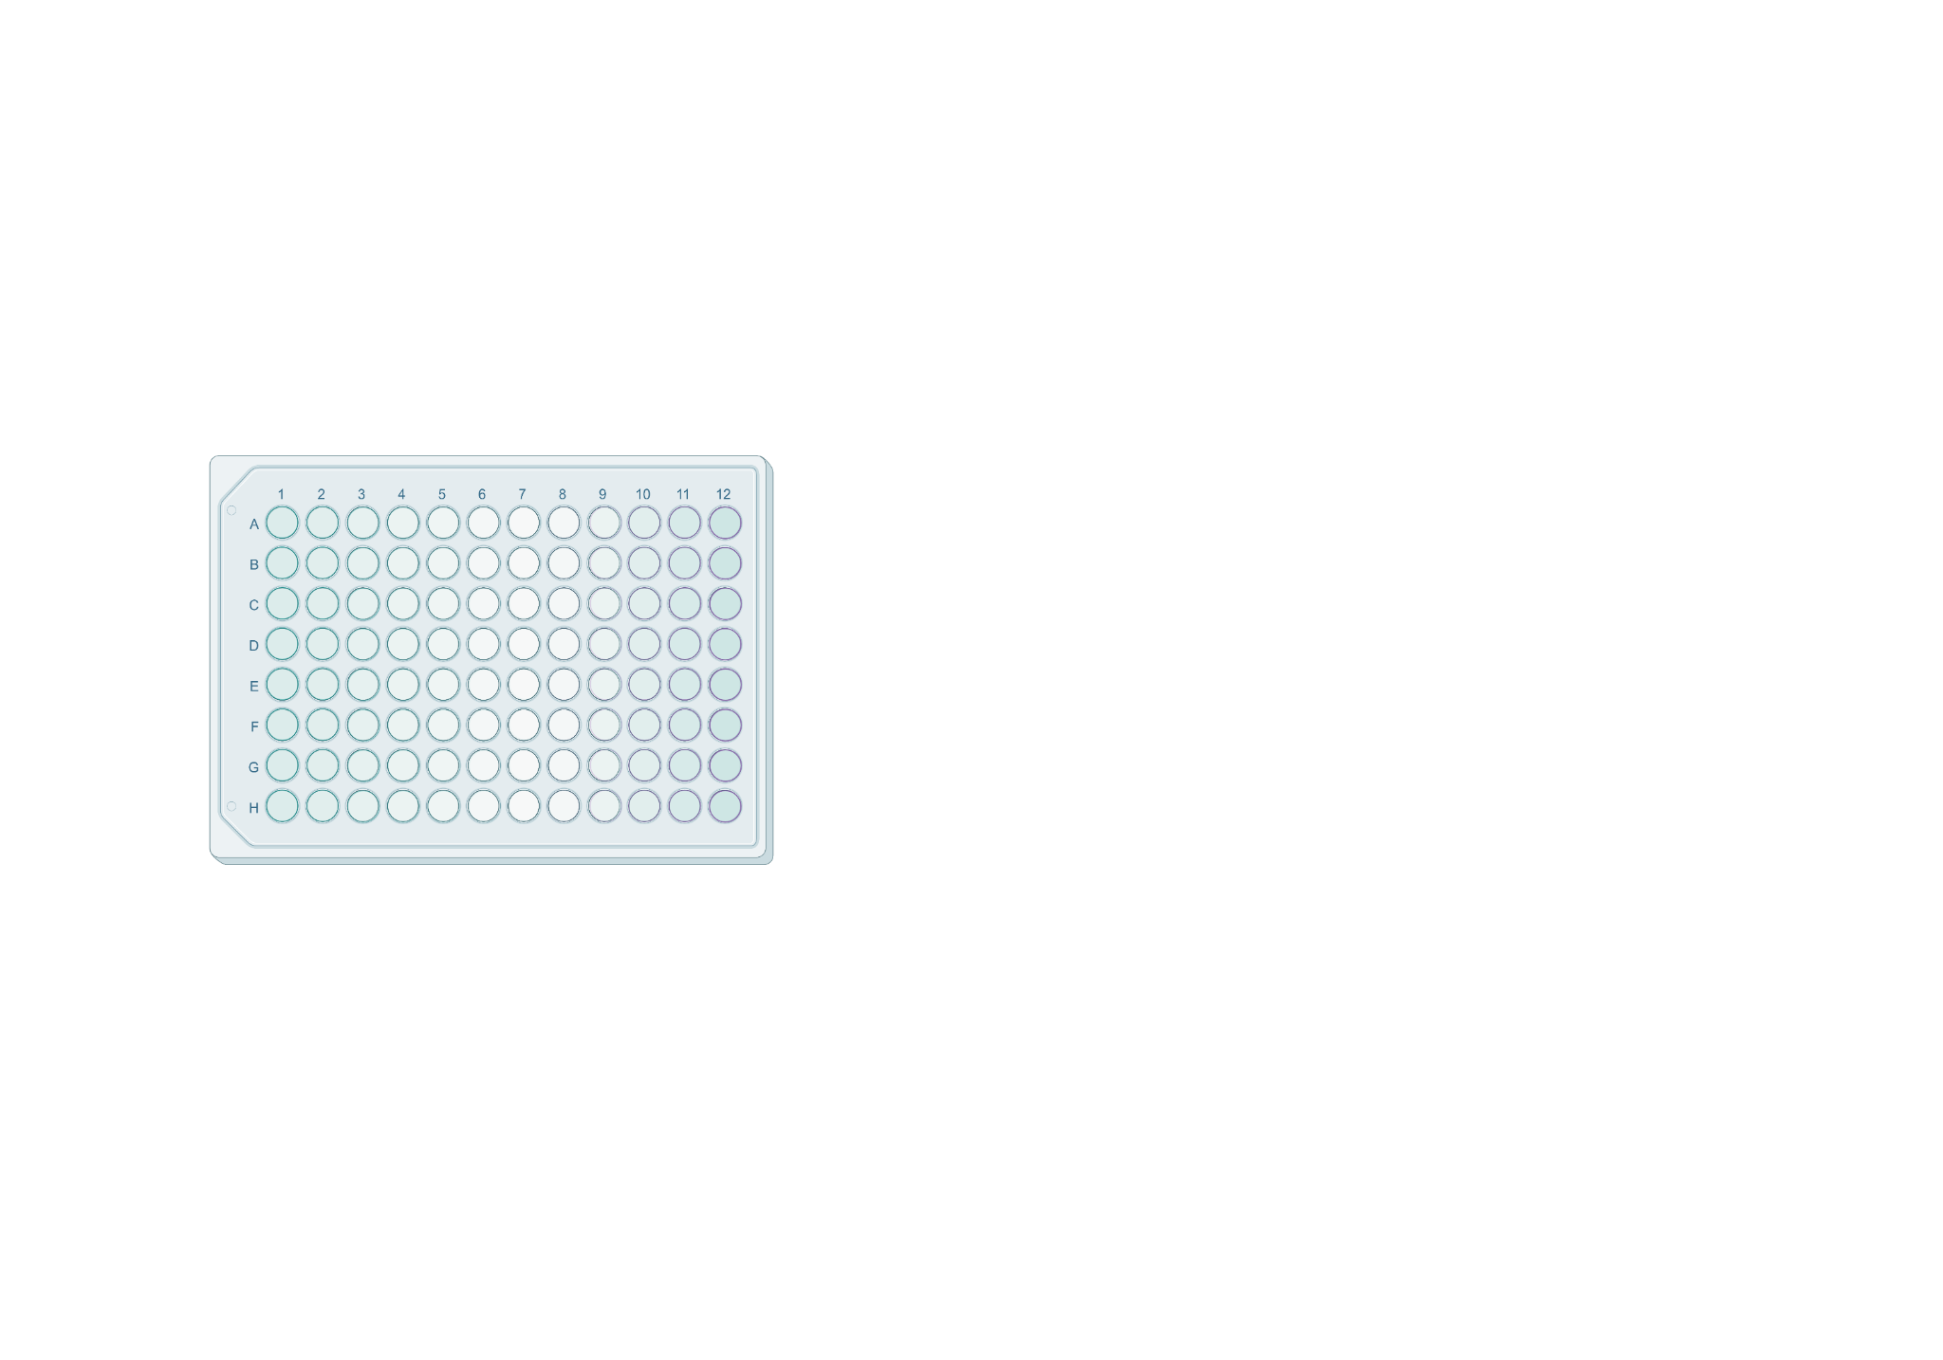
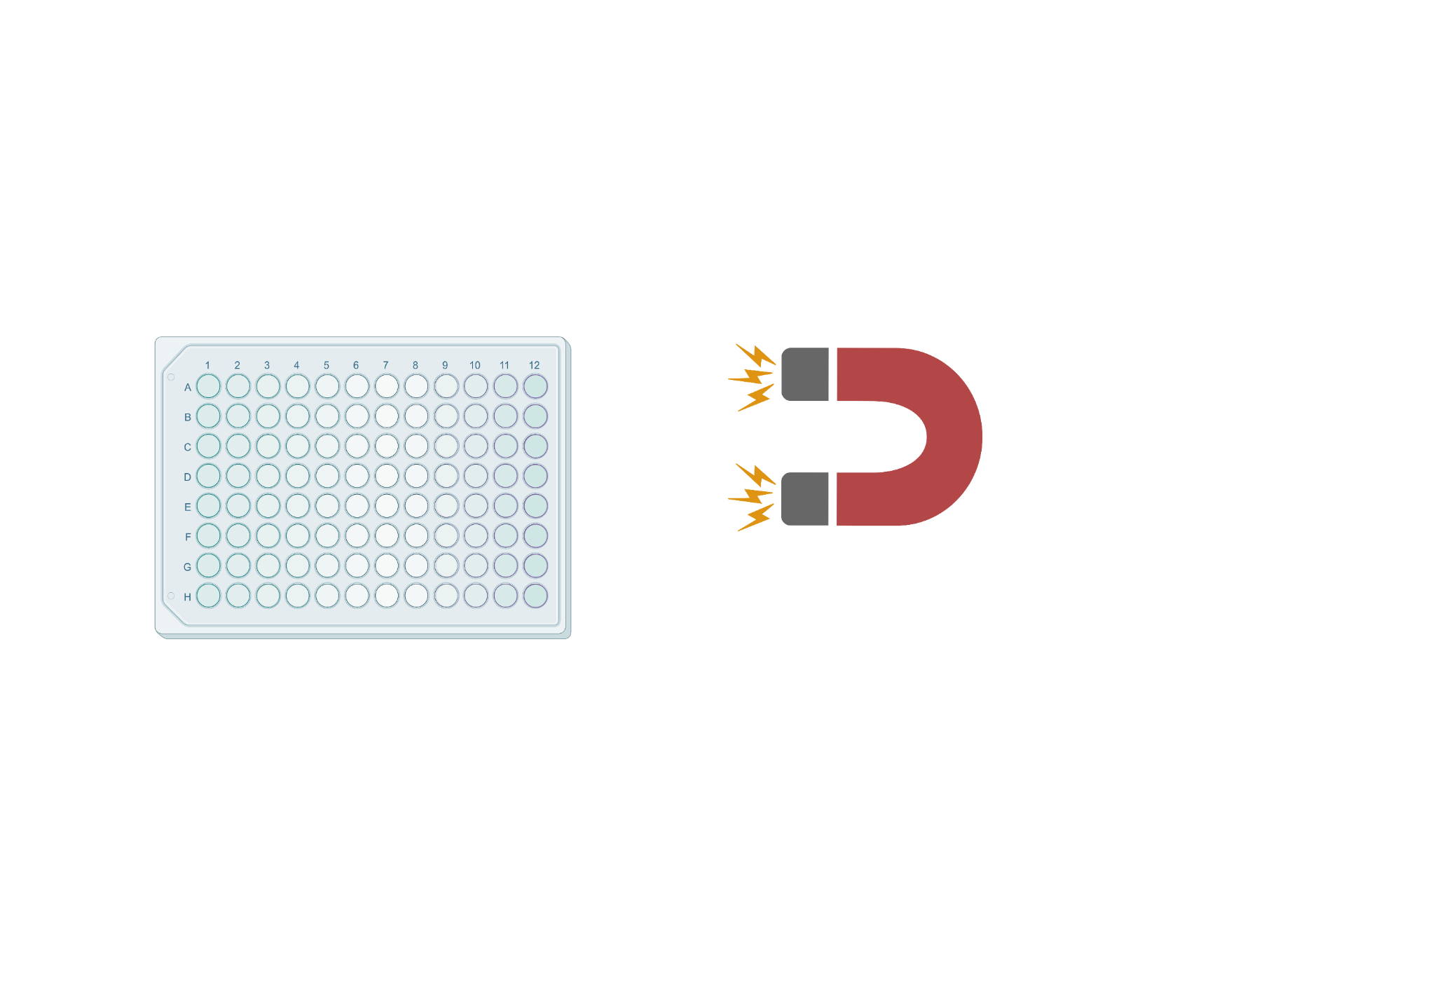


Downstream Steps
Reverse Transcription
Second Strand Synthesis
WTA (PCR)
Library Prep
NGS and Analysis
Magnetic SPRI Extraction
RNA
DNA
Debris
Notes:
Once we have our double stranded DNA with the universal primer sequence for amplification, we amplify the cDNA product using the ISPCR primer for whole transcriptome amplification. The number of PCR cycles can vary based on the sample type. Once amplified, we isolate our WTA product through 2 rounds of SPRI purification using Ampure Spri at 0.6x and 0.8x volumetric ratio respectively. We then quantify our product using Qubit to measure concentration before prepping the sequencing library

Slide 39
Library Preparation- Downstream Steps
Reverse Transcription
Second Strand Synthesis
WTA (PCR)
Library Prep
NGS and Analysis
Notes:
The WTA product is then tagged randomly with the Nextera barcodes. During tagmentation, the DNA gets cleaved into random fragments, however, only the 3’ end of cDNA fragment with a s7 sequence, a universal illumina adapter, will be amplifiable and used for library prep and sequencing. The P7 primer anneals to the 3’ end and a P5 primer anneals to the 5’ end of the cDNA. The transposase adds these adapters randomly which are essential for illumina sequencing, usually half of the library will get amplified.

Slide 40

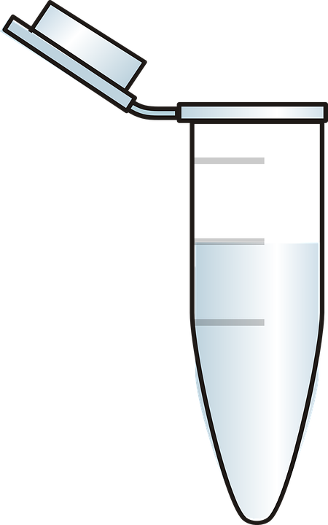

Library Preparation- Downstream Steps
Reverse Transcription
Second Strand Synthesis
WTA (PCR)
Library Prep
NGS and Analysis
Pooled cDNA Library
Data Analysis
Notes:
The final library product is then cleaned via magnetic spri extraction, pooled and quality controlled before being sequenced. Read 1 corresponds to the cell barcode and UMI, index 1 corresponds the well specific barcode to keep track of the samples and read 2 corresponds to the genes of interest. The samples can then be sequenced on a miseq, nextseq or novaseq, each which produce different number of reads. the data is then demultiplexed and aligned to produce a matrix where the rows are genes and columns are cells. This data can then be quality controlled and analyzed, here we show a TSNE plot, a common analysis tool for scRNA seq data.

Slide 41









Summary of Single-Cell Expression Profiling Pipeline
Sample preparation
Cell capture
and barcoding
Library prep
Sequencing
MiSeq
FACS
Micro-capture
Droplet
Nanowell
Split/pool
barcoding
PolyA vs random priming
3’/5’ end tagging vs full-length
PCR vs in vitro transcription
…
~20M reads
NextSeq
~ 500M Reads
NovaSeq:
~ 6B Reads

Slide 42

Sequencing Considerations

Slide 43



Sequencers
MiSeq
NextSeq 500
NextSeq 2000
NovaSeq
~20M reads
~ 500M Reads
~ 1.2B Reads
~ 6, 10 or 25B Reads
Price
Notes:
10X Sequencing:
VDJ 5,000 read pairs per cell
25M per 10X
GEX 20,000 read pairs per cell
100M per 10X
SS2:

Slide 44

Sequencing

Slide 45
Loading the Illumina NextSeq 500/550 Sequencer
Dilute sample to 4nM
Make fresh 0.2N NaOH
Make fresh 0.2M Tris-HCl
Add 5 µL each of NaOH and 4nM sample, wait 5 min
Add 5 µL of Tris-HCl to neutralize
Dilute sample to 2.2pM using more HT1
For Seq-Well:
Use HT1 to dilute the custom read primer to yield 2mL at 0.3µM final concentration
Notes:
If 2nM do 10uL of each

Slide 46

NextSeq 500/550
1.3 mL of sample into position 10
2 mL of custom read 1 into position 7

Slide 47


Nonpatterned flow cells can lead to greater data loss due to over-clustering

Slide 48

26
90
10
10

Slide 49
26
150
10
10

Slide 50
30
30
8
8

Slide 51

Loading the NextSeq 2000
Dilute sample to 2nM using water
Dilute further to 750pM using RBS wth Tween 20
Load 20µL of sample into library position
For Seq-Well:
Use HT1 to dilute each custom read primer mix to yield 600µl at 0.3µM final concentration
Add to either Custom 1 or 2 position

Slide 52
Loading the NextSeq 2000
For Honeycomb:
Use HT1 to dilute each custom read primer mix to yield 600µl at 0.3µM final concentration
Use HT1 to dilute each custom read primer mix to yield 600µl at 0.6µM final concentration
Mix 225µl of 2 of the primers and add to Custom 1
Mix 225µl of the remaining 2 primers and add to Custom 2

Slide 53


